Slide 1
Calculo Numérico I Descomposición LU e inversión de matrices
Dr. Luis Sanchez

Slide 2
LU Decomposition and Matrix Inversion
Gauss elimination, in which the forward elimination comprises the bulk of the computational effort, can be implemented as an LU decomposition.
Provides an efficient way to compute matrix inverse by separating the time-consuming elimination of the Matrix [A] from manipulations of the right-hand side {B}.

Slide 3
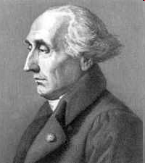

LU Decomposition: Introduction
LU decomposition was originally derived as a decomposition of quadratic and bilinear forms. Lagrange, in the very first paper in his collected works ( 1759) derives the algorithm we call Gaussian elimination. Later Turing introduced the LU decomposition of a matrix in 1948 that is used to solve the system of linear equation.
Let A be a m × m with nonsingular square matrix. Then there exists two matrices L and U such that, where L is a lower triangular matrix and U is an upper triangular matrix.
and
Where,
J-L Lagrange
(1736 –1813)
A. M. Turing
(1912-1954)

Slide 4
Introduction
Gauss elimination solves [A] {x} ={B}
LU decomposition works on the matrix [A] and the vector {B} separately.
LU decomposition is very useful when the vector of variables {x} is estimated for different parameter vectors {B} since the forward elimination process is not performed on {B}.

Slide 5
LU Decomposition
If:
L: lower triangular matrix
U: upper triangular matrix
Then,
[A]{X}={B} can be decomposed into two
matrices [L] and [U] such that:
1. [L][U] = [A] ➔ ([L][U]){X} = {B}

Slide 6
LU Decomposition
Consider:
[U]{X} = {D}
So, [L]{D} = {B}
2. [L]{D} = {B} is used to generate an intermediate vector {D} by forward substitution.
3. Then, [U]{X}={D} is used to get {X} by back substitution.

Slide 7
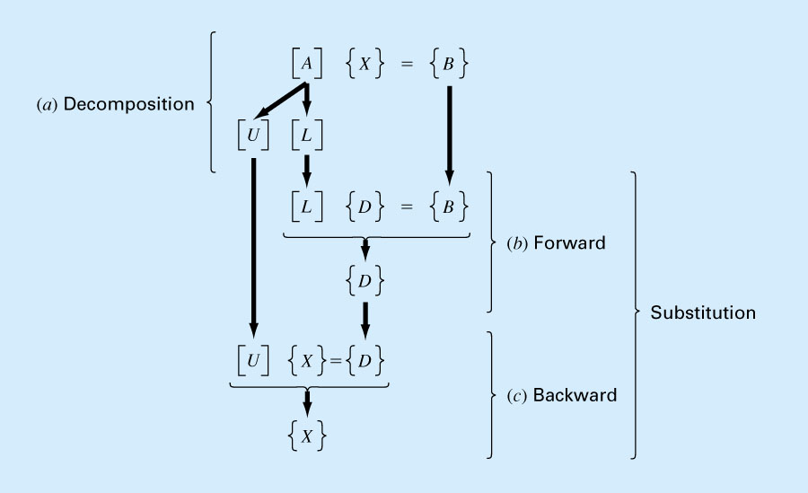
Summary of LU Decomposition

Slide 8
LU Decomposition
As in Gauss elimination, LU decomposition must employ pivoting to avoid division by zero and to minimize round off errors. The pivoting is done immediately after computing each column.

Slide 9
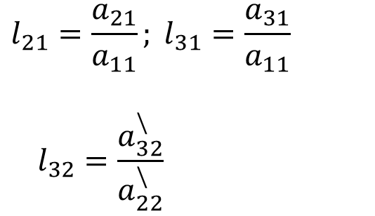
LU Decomposition
System of linear equations [A]{x}={B}
$$l_{21}=\frac{a_{21}}{a_{11}}; l_{31}=\frac{a_{31}}{a_{11}}$$
$$l_{32}=\frac{a_{32}^{\backslash }}{a_{22}^{\backslash }}$$
Step 1: Decomposition

Slide 10
LU Decomposition
Step 2: Generate an intermediate vector {D} by forward
substitution
Step 3: Get {X} by back substitution.

Slide 11
LU Decomposition-Example

Slide 12
LU Decomposition-Example (cont’d)
Use previous L and D matrices to solve the system:
Step 2: Find the intermediate vector {D} by forward substitution

Slide 13
LU Decomposition-Example (cont’d)
Step 3: Get {X} by back substitution.

Slide 14
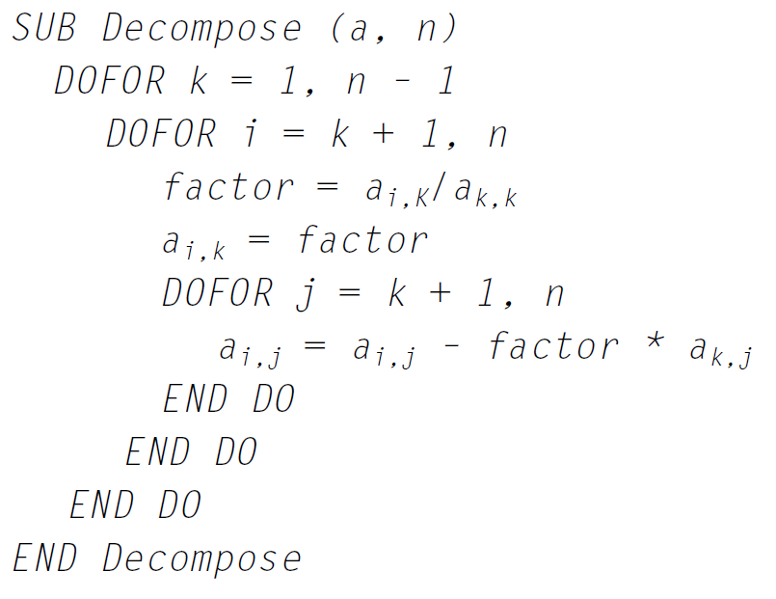
El siguiente es el pseudocódigo de una subrutina para realizar la fase de descomposición:

Slide 15
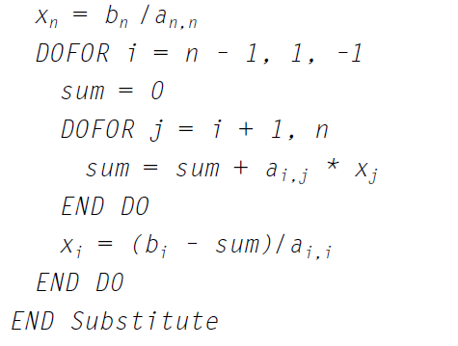
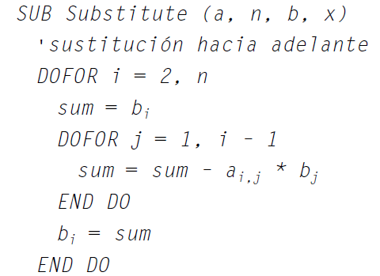
El siguiente es el pseudocódigo de una subrutina para implementar ambas fases de sustitución:
Sustitución hacia atrás
Sustitución hacia adelante

Slide 16
Codigo de Matlab para la Implementacion de ambas fases de sustitución:
% Solve the lower triangular system Ly = b %(forward substitution)
y = zeros(n,1);
y(1) = b(1);
for i = 2:n,
y(i) = b(i)-L(i,1:i-1)*y(1:i-1);
end
% Solve the upper triangular system Ux = y %(back substitution)
x = zeros(n,1);
x(n) = y(n)/U(n,n);
for i = n-1:-1:1,
x(i) = (y(i)-U(i,i+1:n)*x(i+1:n))/U(i,i);
end
end

Slide 17
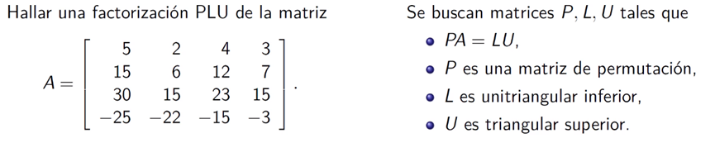
Factorizacion PLU

Slide 18
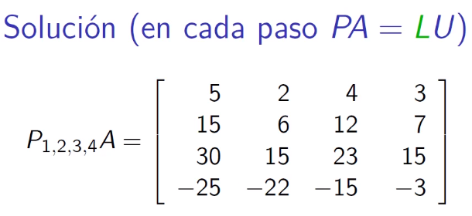
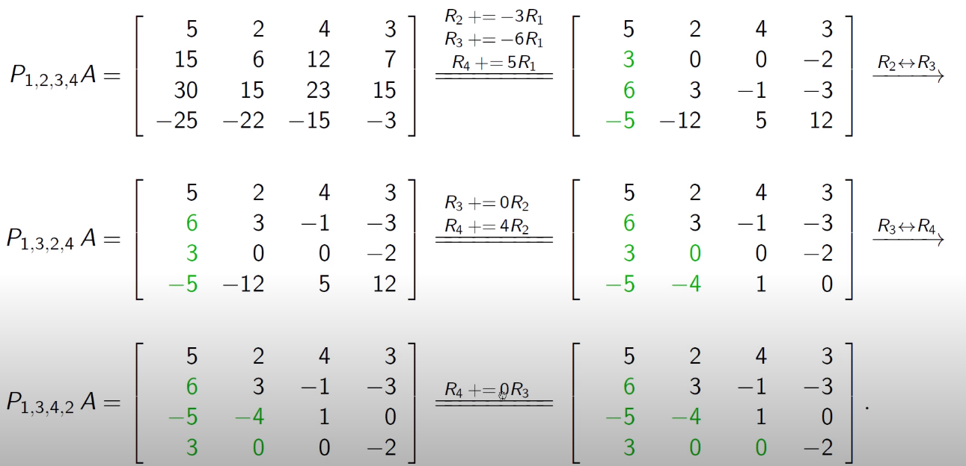

Slide 19
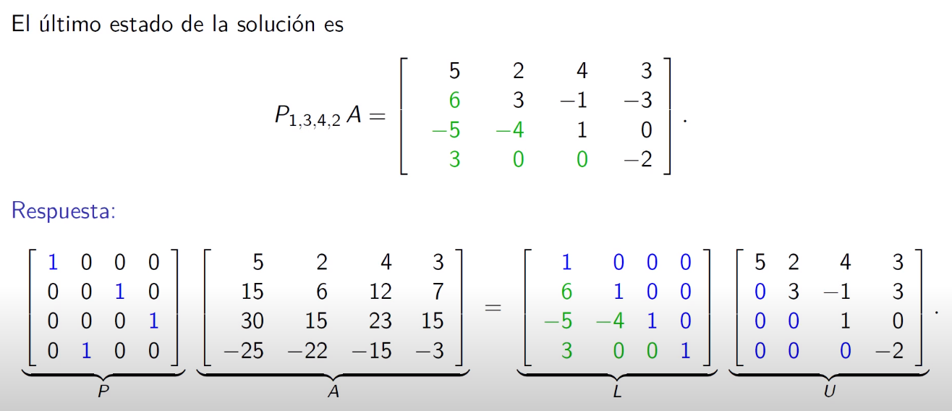

Slide 20
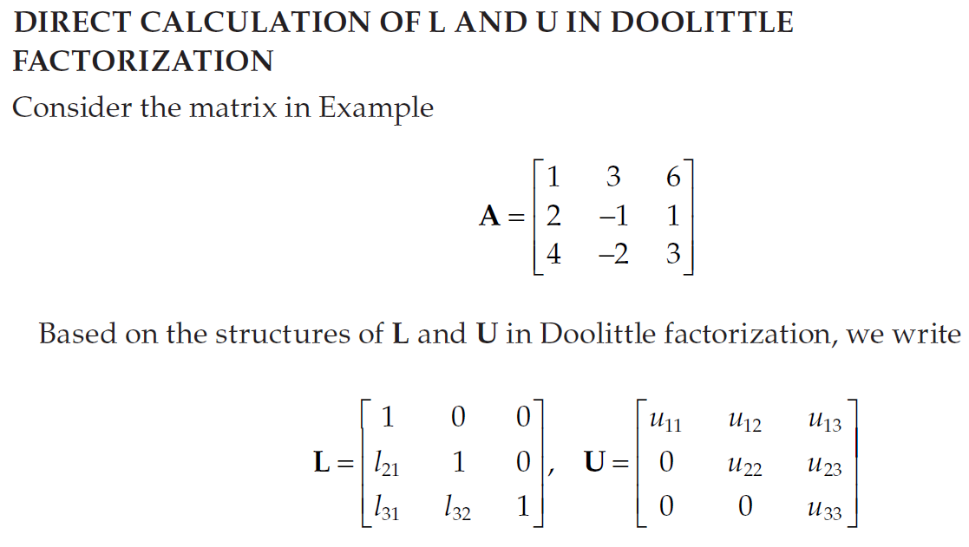

Slide 21
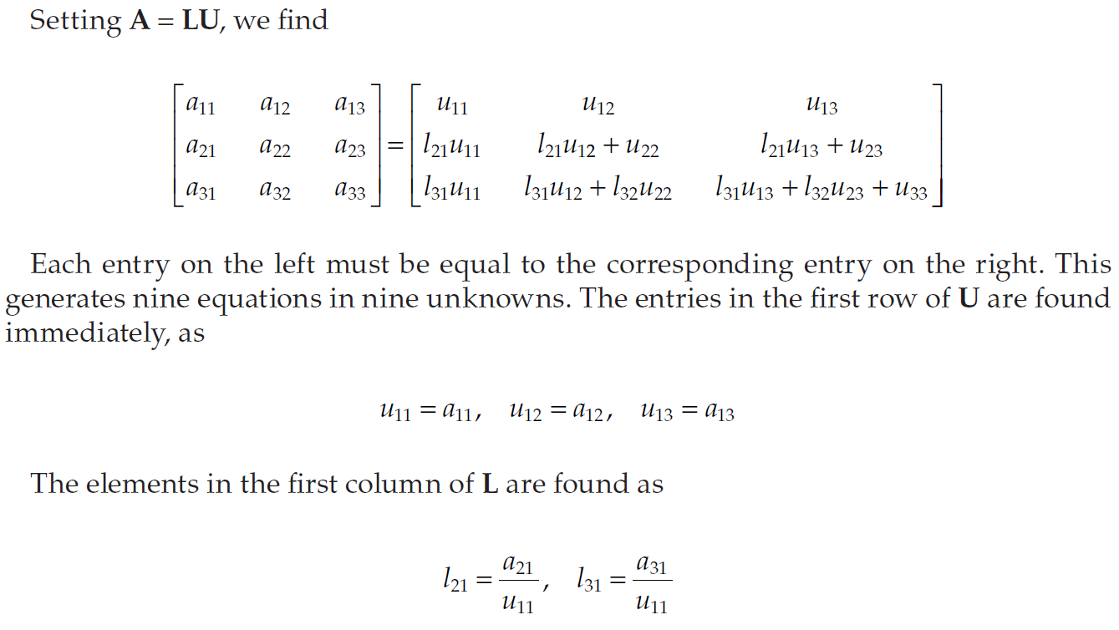

Slide 22
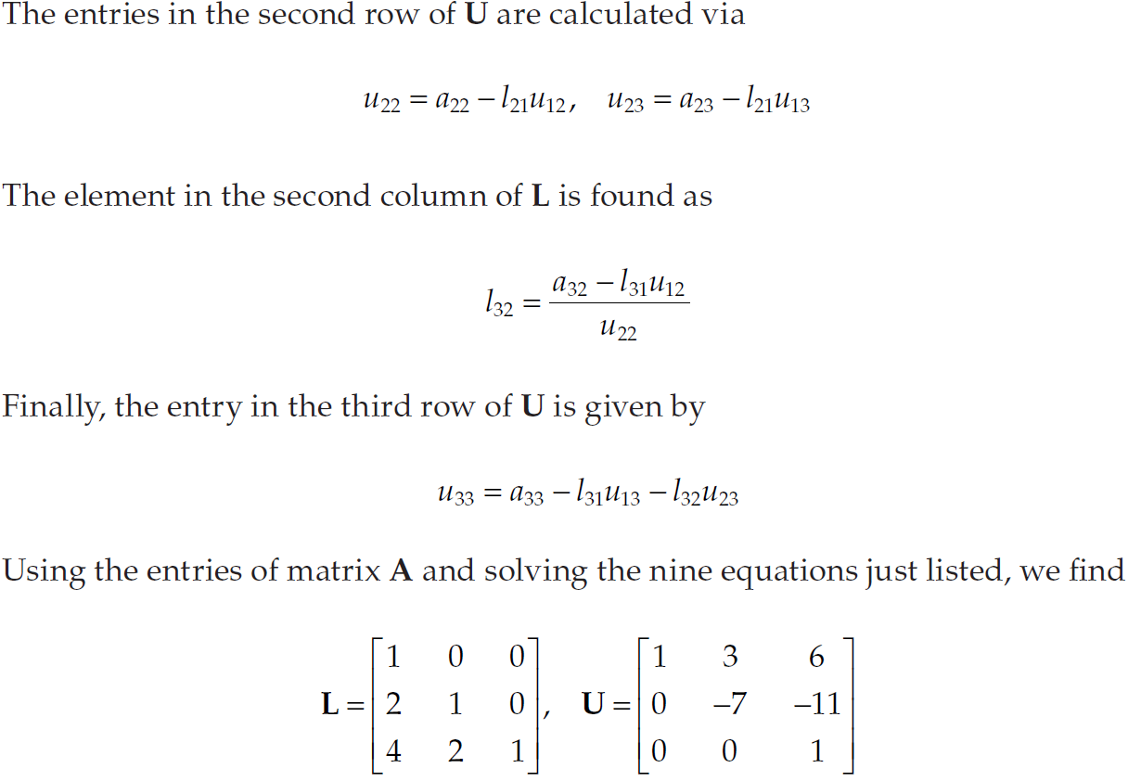

Slide 23
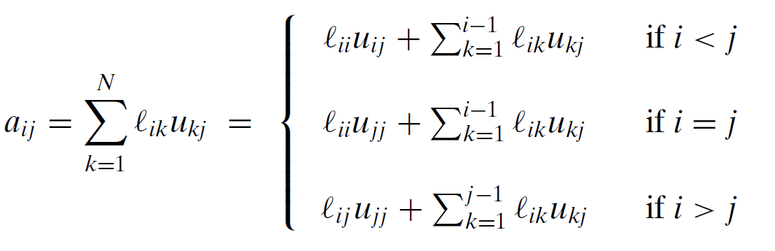
Crout, Doolittle, and Choleski Methods for LU Decomposition
To find an LU decomposition of A, we can use the equations for a_{ij} resulting from the special structure of L and U,
Various LU decomposition algorithms are possible by imposing some additional conditions. Crout’s method uses the condition u_{jj} = 1, whereas Doolittle’s method uses the condition l_{ii} = 1. Another LU decomposition known as Choleski’s method is possible if A is symmetric and positive definite, by setting L = U^{T} , that is, LL^{T} = A.

Slide 24
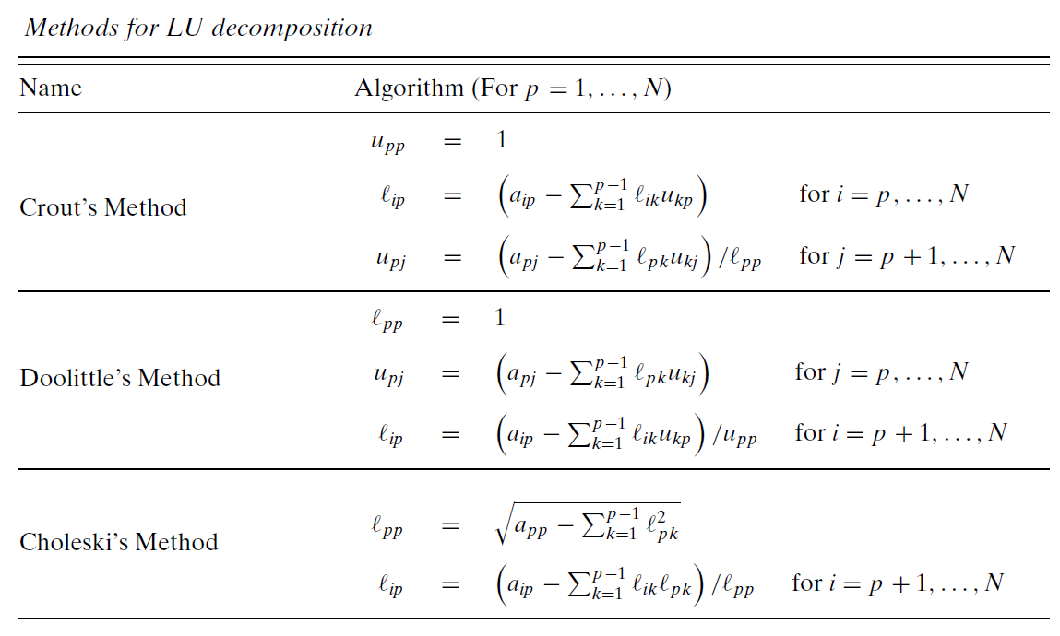

Slide 25
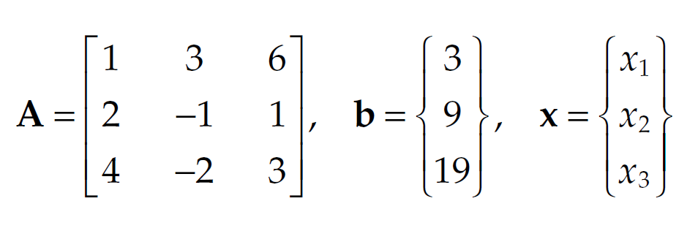
Ejercicio 01
Implemente un Script en Matlab para resolver el sistema Ax = b
Usando la descomposición LU

Slide 26
Matrix Inverse Using the LU Decomposition
LU decomposition can be used to obtain the inverse of the original coefficient matrix [A].
Each column j of the inverse is determined by using a unit vector (with 1 in the j^{th} raw ).

Slide 27
Matrix Inverse: LU Decomposition
[A] [A]⁻¹ = [A]⁻¹[A] = I
1st column of [A]⁻¹
2nd column of [A]⁻¹
3rd column of [A]⁻¹

Slide 28
Matrix inverse using LU decomposition Example
1A. [L]{d}₁ = {b}₁
1st column of [A]⁻¹
1B. Then, [U]{X}₁={d}₁

Slide 29
Matrix inverse using LU decomposition Example (cont’d)
2A. [L]{d}₂ = {b}₂
2B. Then, [U]{X}₂={d}₂
2nd column of [A]⁻¹

Slide 30
Matrix inverse using LU decomposition Example (cont’d)
3A. [L]{d}₃ = {b}₃
3B. Then, [U]{X}₃={d}₃
3rd column of [A]⁻¹

Slide 31
Matrix inverse using LU decomposition Example (cont’d)

Slide 32
Ejercicio:
Implemente un Live Script para calcular la Matriz inversa de:

